Slide 1



Docker Presentation for the State of Florida
christine.lovett@docker.com
al.barnes@docker.com
July 26, 2018

Slide 2

[Logo Placeholder]
Agenda:
Overview of Docker
Candidates for Containerization
Dockerfile Best Practices
Cluster Architecture and Orchestration
Building Secure Software Supply Chains
Live Demo

Slide 3
[Logo Placeholder]
The Docker Enterprise Container Platform Enabling the Software Supply Chain
Diverse Applications
Disparate Infrastructure
Lifecycle Management
Orchestrate Complex Systems
Secure by Default
Edge / IoT
Serverless Anywhere

Slide 4
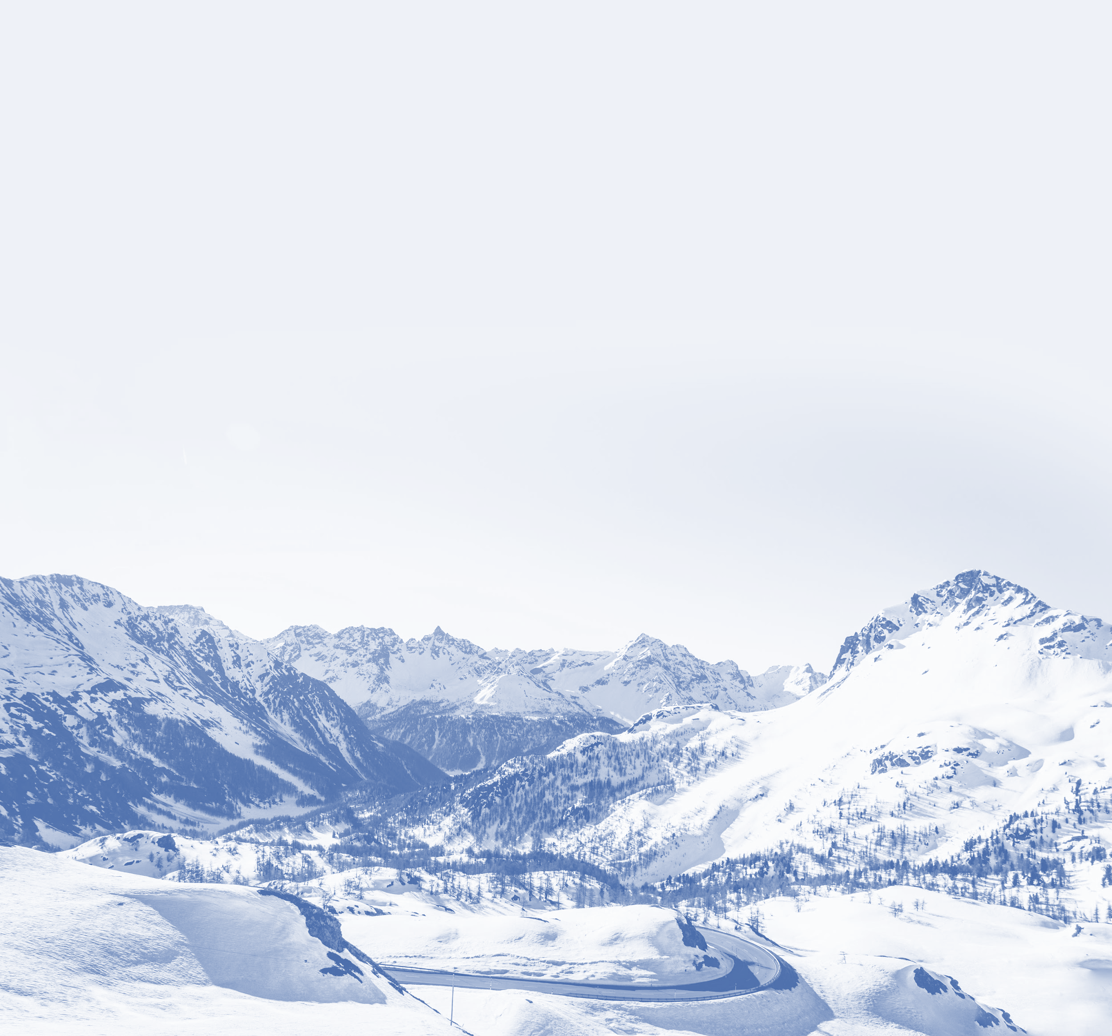
[Logo Placeholder]
Only Docker Delivers All Three Core Enterprise Requirements
Docker EE is built to enable these core objectives
Choice
Agility
Security
Hybrid and multi-clouds
Windows and Linux
Traditional apps and microservices
DevOps and existing ops processes
Unified operations
Rapid delivery and response
Cost efficiency
Safer apps
Governance
Chain of custody
Threat mitigation

Slide 5
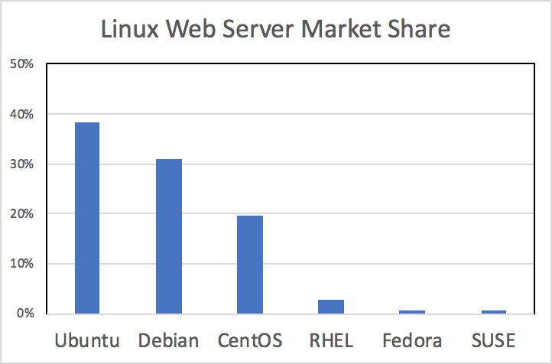
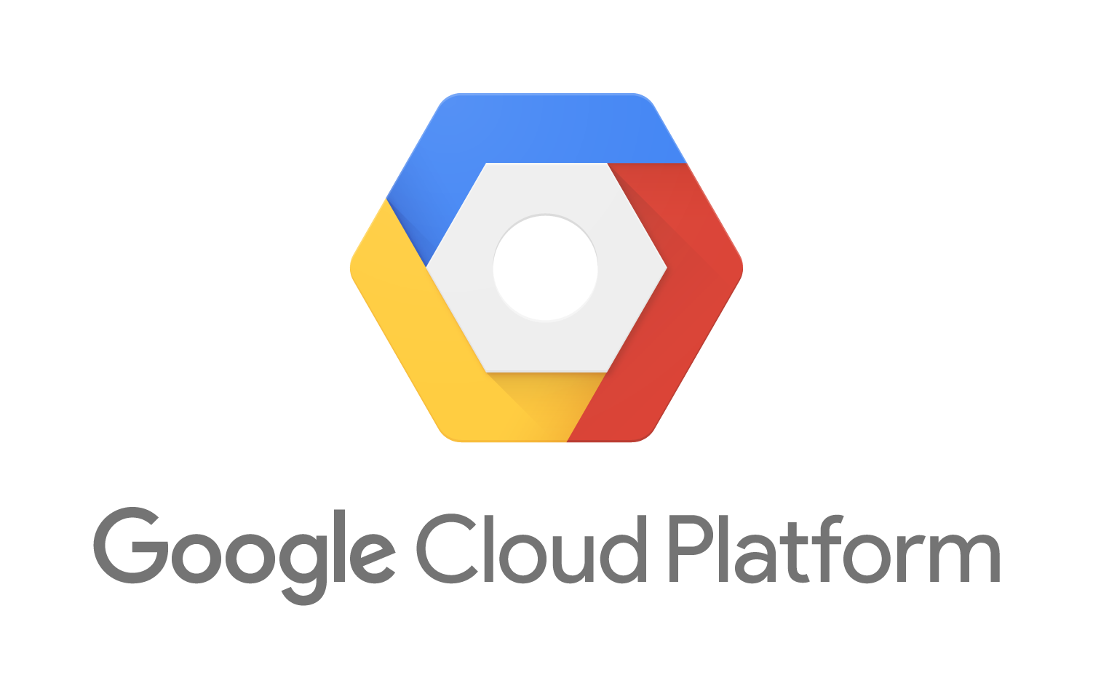
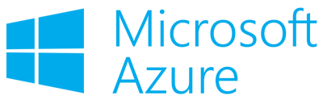
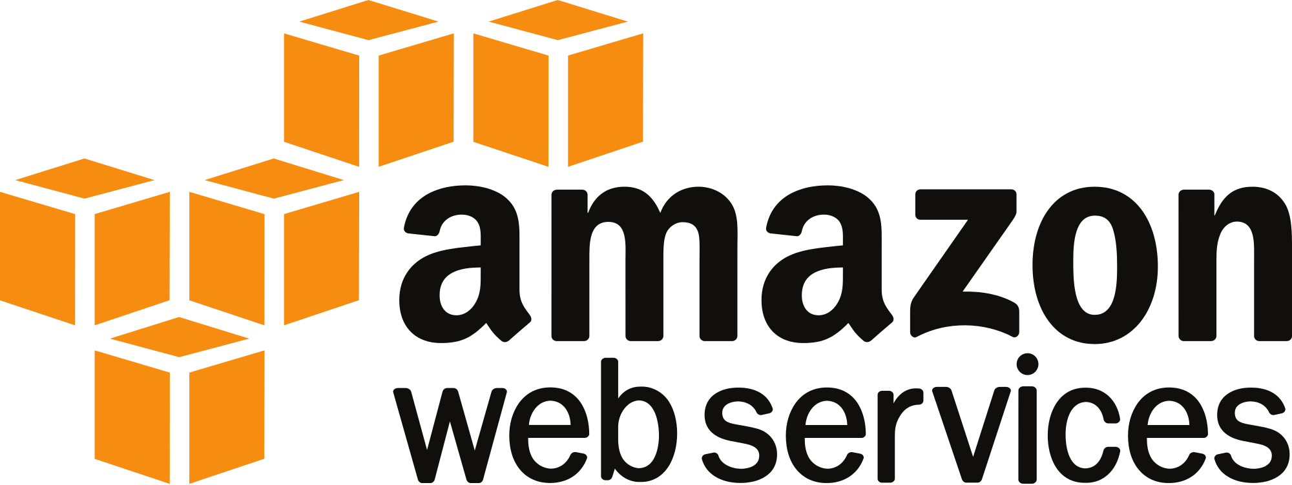
[Logo Placeholder]
CHOICE
Only Container Platform that is Multi-Linux, Multi-OS and Multi-Cloud
81%
companies with 1,000+ employees have multiple clouds
Source: Rightscale 2018 State of the Cloud Report
Source: https://w3techs.com/technologies/details/os-linux/all/all
Docker Enterprise Edition is certified to run on CentOS, RHEL, Ubuntu, SUSE, Oracle Linux and Windows Server and can be deployed into all major public clouds while maintaining the same operating experience

Slide 6
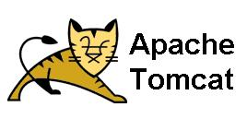
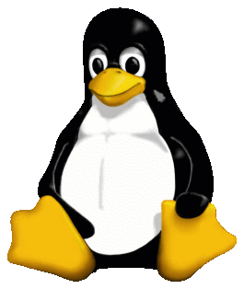
[Logo Placeholder]
CHOICE
CHOICE
Only Container Platform to Deliver First-Class Support and Interoperability across Linux and Windows
App-Net:
10.0.0.0/24
10.0.0.1
10.0.0.2
Node
Node
Node
Node
Worker
Worker
Worker
Worker
Worker Nodes
Leverage best-in-class technologies across Windows and Linux
Connect Windows and Linux containers in the same cluster through a common overlay network
Build Compose files for hybrid applications
Leverage labels and constraints for intelligent placement and scheduling

Slide 7


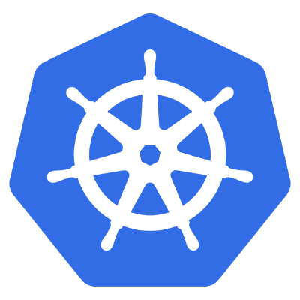
[Logo Placeholder]
CHOICE
CHOICE
Choice of Swarm and Kubernetes: Only Solution That Lets You Run Swarm Today, Kubernetes Tomorrow and Vice Versa
Docker EE Orchestration
Docker EE is the only platform that allows you to run both Swarm and Kubernetes in the same cluster:
Developers do not need to select orchestrators
Freedom to change orchestrators as needs arise
EE Manager Nodes are both Swarm and Kubernetes enabled
Every worker node is both Kubernetes API- and Swarm API-ready
Secure Cluster Management
App Scheduler
Swarm
OR
Kubernetes
Node
Node
Node
Docker EE Cluster

Slide 8
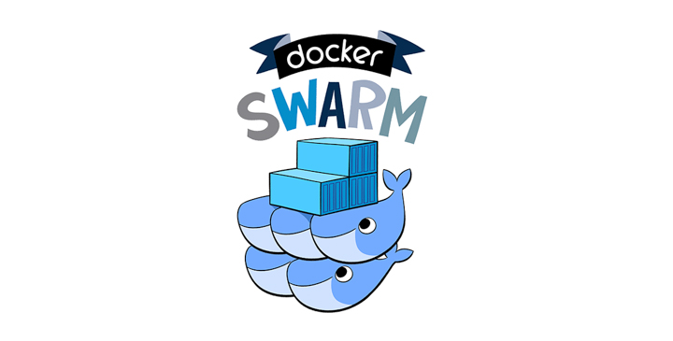
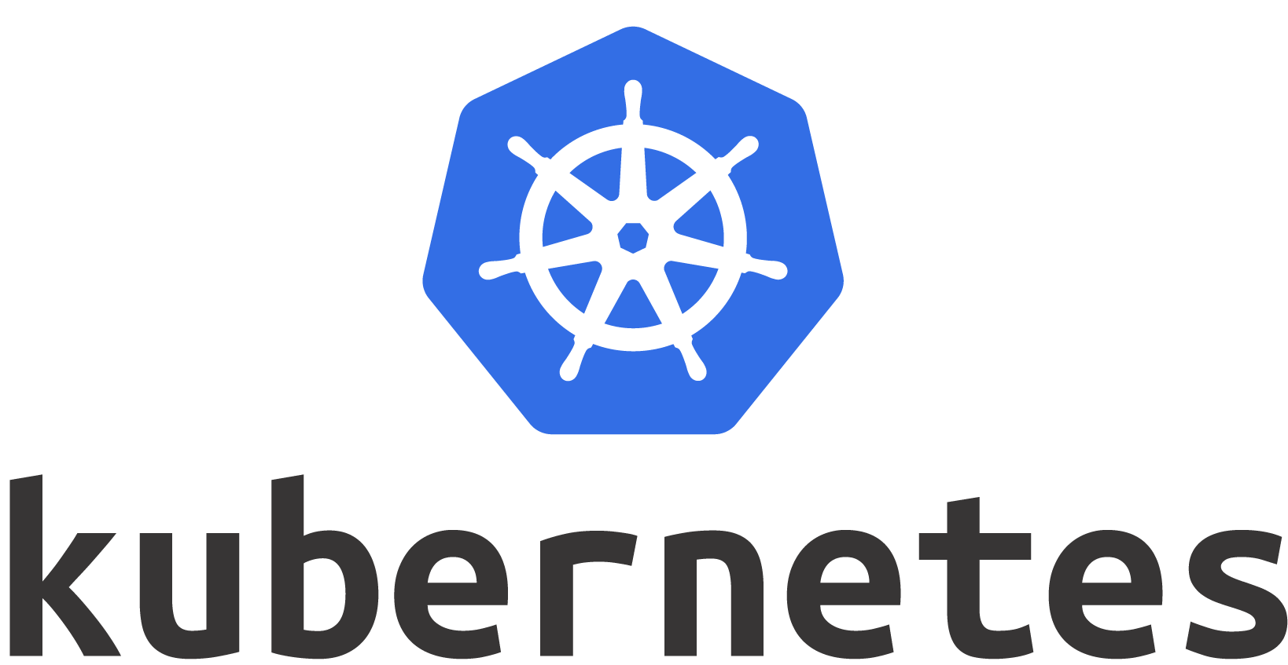

[Logo Placeholder]
End-to-end container lifecycle
Lifecycle Mgt
Governance
Security
Orchestration
CONTAINER
Image format & runtime
CONTAINER ORCHESTRATION
Container placement & scheduling
Automated, Open and Extensible
DOCKER ENTERPRISE EDITION
Organizations also require Lifecycle Management + Governance + Security + Automation + Extensibility
Presenting Workgroup

Slide 9
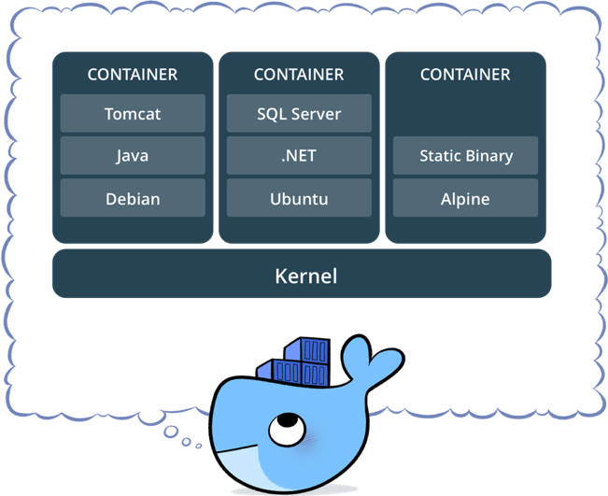
[Logo Placeholder]
What is a container?
Standardized packaging for software and dependencies
Isolate apps from each other
Share the same OS kernel
Works with all major Linux distros and Windows Server 2016

Slide 10
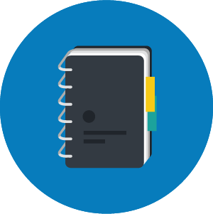

[Logo Placeholder]
How to create a Docker container
Without Docker
100 Page Binder
With Docker
Single Text File
Replace the printed (often out of date) runbooks for app deployment and ops documentation
Define instructions including: ports, volumes, environment variables, health-checks, and more
Dockerfile contains all commands to assemble a Docker container
Dockerfile containing all the instructions to deploy your app.
Enables consistent deployments across multiple environments

Slide 11
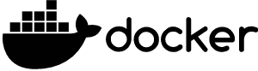
[Logo Placeholder]
Certified Containers
Certified Plugins
Enterprise Edition
Application Composition, Deployment and Reliability
Policy Management
Secure Access and User Management
Application and Cluster Management
Certification and Support
Image Scanning and Monitoring
Content Trust and Verification
Image Management
Integrated App and Cluster Management
Security
Network
Volumes
Distributed State
Container Runtime
Orchestration
Optimized Container Engine
Certified Infrastructure

Slide 12
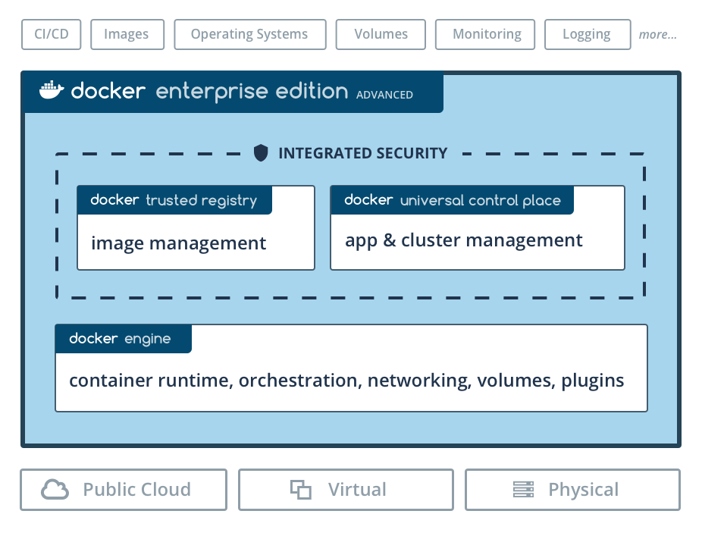
[Logo Placeholder]
Docker EE Components

Slide 13
[Logo Placeholder]
Why containerize applications?

Slide 14
[Logo Placeholder]
Docker containers
Operating Systems Waste Server Capacity
For Immediate Savings
Containers in a VM
For Maximum Cost Reduction
Containers on Bare Metal
App
App
App
App
App
App
App
App
App
App
App
App
App
App
App
App
App
App
App
App
App
App
App
App
App
App
App
App
App
App
App
App
App
App
App
App
“Docker” Engine
App
App
App
App
OS
OS
OS
OS
OS
“Docker” Engine
Hypervisor
Hypervisor
OS
Server
Server
Server
Server Count ↓
VM and OS Licenses ↓
Power, Space, Cooling ↓
Admin ↓

Slide 15
[Logo Placeholder]
Candidates for containerization

Slide 16
[Logo Placeholder]
App Selection
General Guidance
Linux | Windows
Java EE | .NET Framework
Components fundamentally compatible with modern OS (e.g. RHEL 7, WS 2016, etc.)
Server-side only components (no GUI)
Requires little / no refactoring

Slide 17
[Logo Placeholder]
App Selection
Runtime / App Servers
Linux | Windows
Java EE | .NET Framework 2.0+
 | ASP.NET, Windows Services
Tomcat*, Jetty*, Glassfish*, WebLogic*, WebSphere*, | IIS 6, 7 or 8
Custom applications - Commercial off the Shelf (COTS) not prefered

Slide 18
[Logo Placeholder]
App Selection
Architecture
Linux | Windows
2 or 3 tier app
Up to 5 application components [e.g. service, job, queue, proxy, etc.]
Components do not require clustering (can run as a single node)
Databases can be excluded for containerization (i.e. can be migrated / connected to independently)

Slide 19
[Logo Placeholder]
Best practices

Slide 20
[Logo Placeholder]
Building Efficient Images
Minimize Number of Layers
Bad! Good!
RUN apt-get update
RUN apt-get install -y wget
RUN rm -rf /var/lib/apt/lists/*
RUN apt-get update &&\
apt-get install -y wget &&\
rm -rf /var/lib/apt/lists/*

Slide 21
[Logo Placeholder]
Building Efficient Images
2) Use cache-busting: ensuring you never use cache outdated updates
Bad! Good!
RUN apt-get update
RUN apt-get install -y wget
RUN rm -rf /var/lib/apt/lists/*
RUN apt-get update &&\
apt-get install -y wget &&\
rm -rf /var/lib/apt/lists/*

Slide 22
[Logo Placeholder]
Building Efficient Images
3) Update by version
Good! Better!
RUN apt-get update &&\
apt-get install -y wget &&\
rm -rf /var/lib/apt/lists/*
RUN apt-get update &&\
apt-get install -y wget=1.17.1-1ubuntu1.1 &&\
rm -rf /var/lib/apt/lists/*

Slide 23
[Logo Placeholder]
Building Efficient Images
4) Separate layers that will break the cache to utilize layer caching
BAD! Good!
cOPY . /usr/src
RUN npm install
COPY package.json /usr/src/package.json
RUN npm install
COPY . /usr/src

Slide 24
[Logo Placeholder]
Architecture

Slide 25
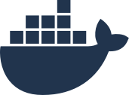

[Logo Placeholder]
Mixed Windows and Linux Clusters
UNIFORMLY OPERATE, MANAGE, AND SECURE WINDOWS AND LINUX CONTAINERS
KEY FEATURES
docker
universal control plane
Extend enterprise security features like image signing, image scanning, and secrets management to both Windows and Linux worker nodes
Leverage the same LDAP/AD integration and RBAC rules across Windows and Linux nodes
Visualize all apps in the same environment
trusted registry
Node
Node
Node
Manager
Manager
Manager
BENEFITS
Improve resource utilization and incur less management overhead with centralized management across Windows and Linux apps
Reduce risk with consistent processes and policies across Windows and Linux apps
Node
Node
Node
Node
Worker
Worker
Worker
Worker

Slide 26


[Logo Placeholder]
Docker Enterprise Edition Architecture
Node
Raft consensus group
UCP worker
Internal distributed store
Node
Deploy / Manage
UCP worker
Node
Node
Node
Node
UCP manager
UCP manager
UCP manager
UCP worker
Node
Image registry
UCP worker
Admin / User
Node
DTR replica worker
BYO TCP load balancer
Add-ons
Node
Logging
Monitoring
DTR replica worker
LDAP/AD
External CA
Node
DTR replica worker
Image storage

Slide 27
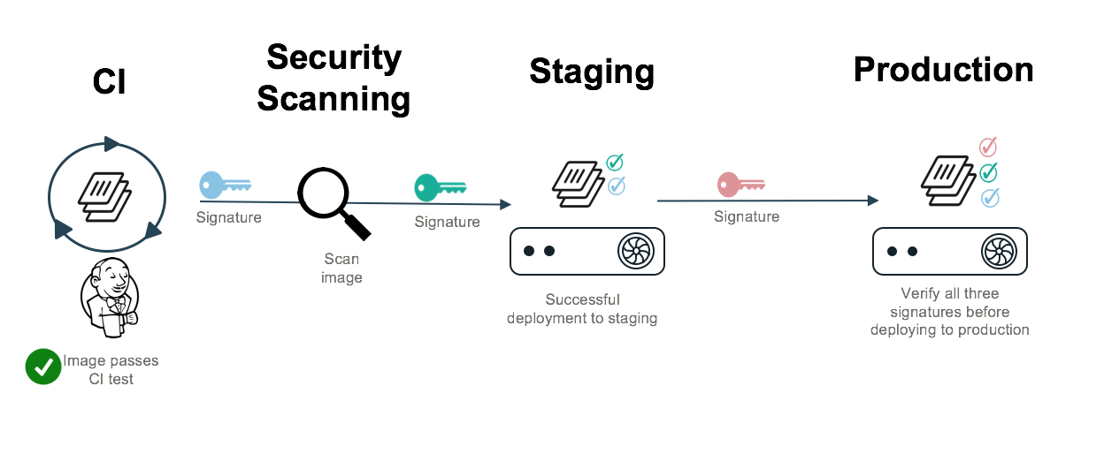
[Logo Placeholder]
Leverage a secure and automated software supply chain
Establish chain of trust with apps as they move across environments
Digitally sign containers and only run verified containers
Freshness guarantee ensures no tampering and latest container is running
Automate workflow with immutable repos and automated image promotion

Slide 28
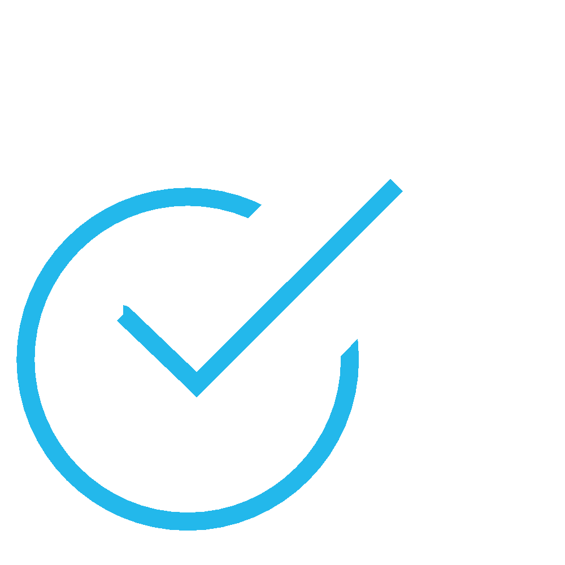
[Logo Placeholder]
Secure Software Supply Chain
UAT
Staging
Production
.
.
.

Slide 29


[Logo Placeholder]
Secure Software Supply Chain
UAT
Staging
Production
.
.
.

Slide 30
[Logo Placeholder]
Docker EE Deployment Models - Site Redundancy
2 Clusters, 3 Sites
- We try and achieve redundancy by spreading a cluster across sites.
- With 3 Sites (And the addition of a 3rd worker node) we are able balance all of the components correctly.
- If site 1 goes down. You lose ⅓ of your managers, therefore Quorum remains.
- 3 Sites does provide you with Site Redundancy!
Production Cluster
UCP Manager
UCP Manager
UCP Manager
UCP Worker
UCP Worker
UCP Worker
UCP Worker
For DTR
UCP Worker
For DTR
UCP Worker
For DTR
Test Cluster
UCP Manager
UCP Manager
UCP Manager
UCP Worker
UCP Worker
UCP Worker
UCP Worker
For DTR
UCP Worker
For DTR
UCP Worker
For DTR
Site 1
Site 2
Site 3

Slide 31




[Logo Placeholder]
Define Secure Application Zones to Enforce IT Governance
FEATURE / CAPABILITY
Integrate with LDAP/AD and create granular and flexible access controls
Combine Namespace isolation with node-based isolation for increased separation
Ops Team
.NET Dev Team
Using Swarm
Java Dev Team
Using Swarm
Java Dev Team using K8s
docker
enterprise edition
universal control plane
trusted registry
KEY BENEFITS
swarm mode cluster
Easily define resource-based permissions to different teams and expose only the allotted resources to each team
Re-allocate resources as needed
Node
Node
Node
Node
Node
Node
Worker
Worker
Worker
Worker
Worker
Worker

Slide 32
[Logo Placeholder]
Why not use separate clusters instead of application zones?
Cluster sprawl
Operations Team
Redundant management
Higher cost (more nodes)
Disconnected policies & controls
Higher chance of errors
DOCKER EE
MANAGEMENT PLANE
DOCKER EE
MANAGEMENT PLANE
DOCKER EE
MANAGEMENT PLANE
DOCKER EE
MANAGEMENT PLANE
SANDBOX
TEST
STAGING
PRODUCTION
Single cluster, multiple divided zones

Slide 33
[Logo Placeholder]
Define Secure Application Zones to Enforce IT Governance
Benefits of Secure Application Zones:
Higher resource utilization
Specialization of skill sets for discrete layers of IT stack
Separation of responsibilities for more resilient and manageable architectures
Tenant A
Tenant B
Tenant C
app
app
app
app
orchestration platform
physical infrastructure

Slide 34

Cluster Resources
[Logo Placeholder]
infra admins
developers
production operations
security
monitoring
container 1
container 2
app
app
virtual resources
secrets
images
networks
volumes
services
host
host
host
physical resources
CPU
memory
I/O
storage

Slide 35
[Logo Placeholder]
Docker Certified Infrastructure

Slide 36

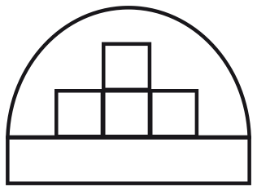
Docker Certified Infrastructure:
Reliably Deploy and Manage Docker Enterprise Edition On Your Infrastructure
[Logo Placeholder]
Reference Architecture
Automation & Tooling
Ecosystem Integration
Detailed design and deployment considerations
Templates and scripts to automate deployment
Open, extensible work with popular 3rd party tools
Best practices developed in real world deployments
Spend more time on your apps
Integrate with what you have

Slide 37
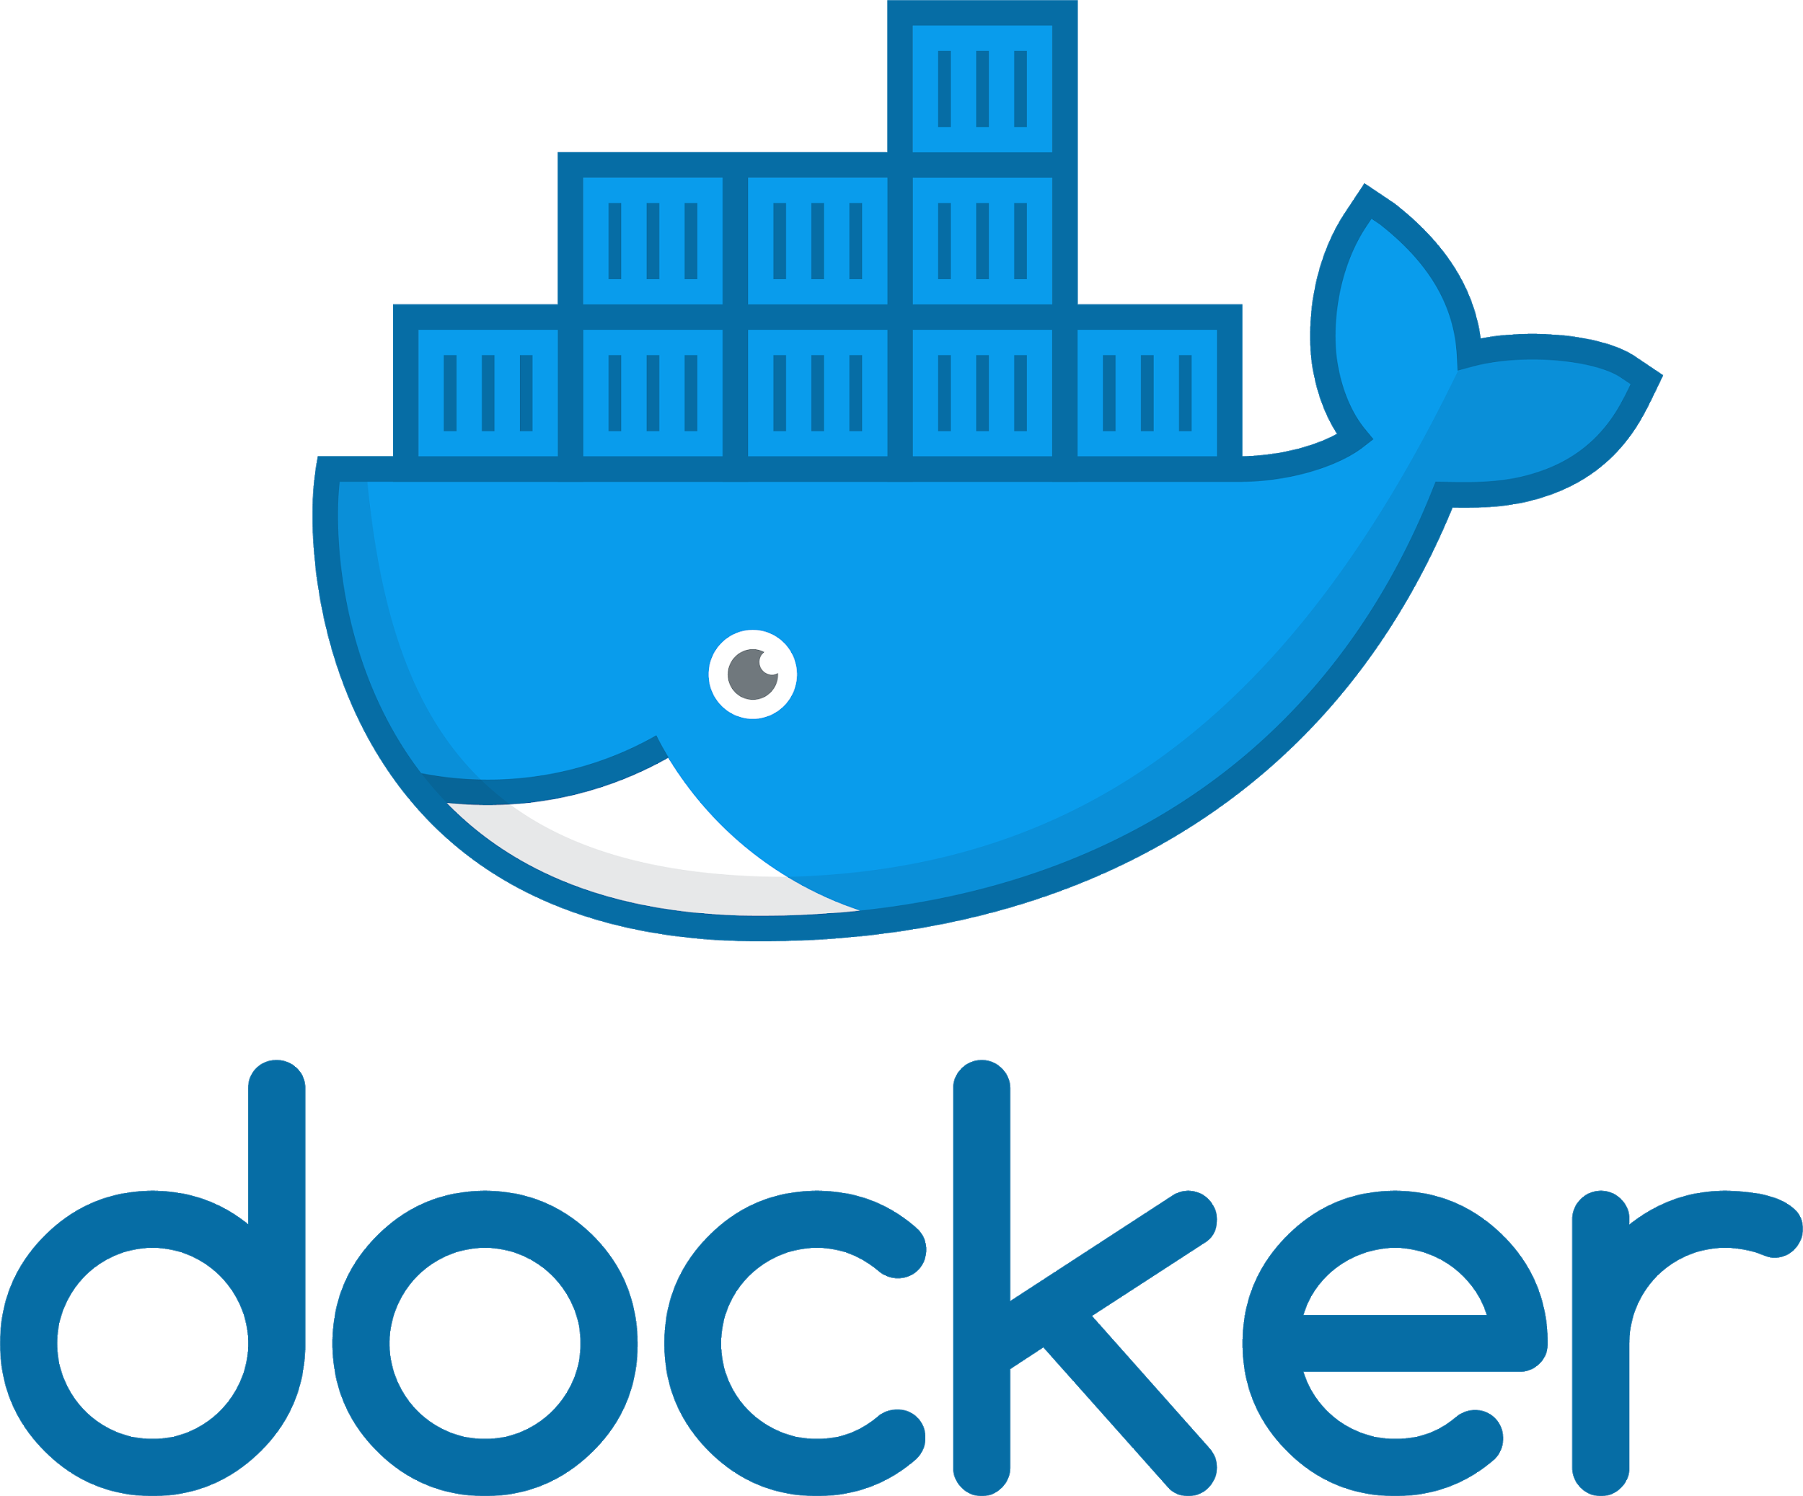
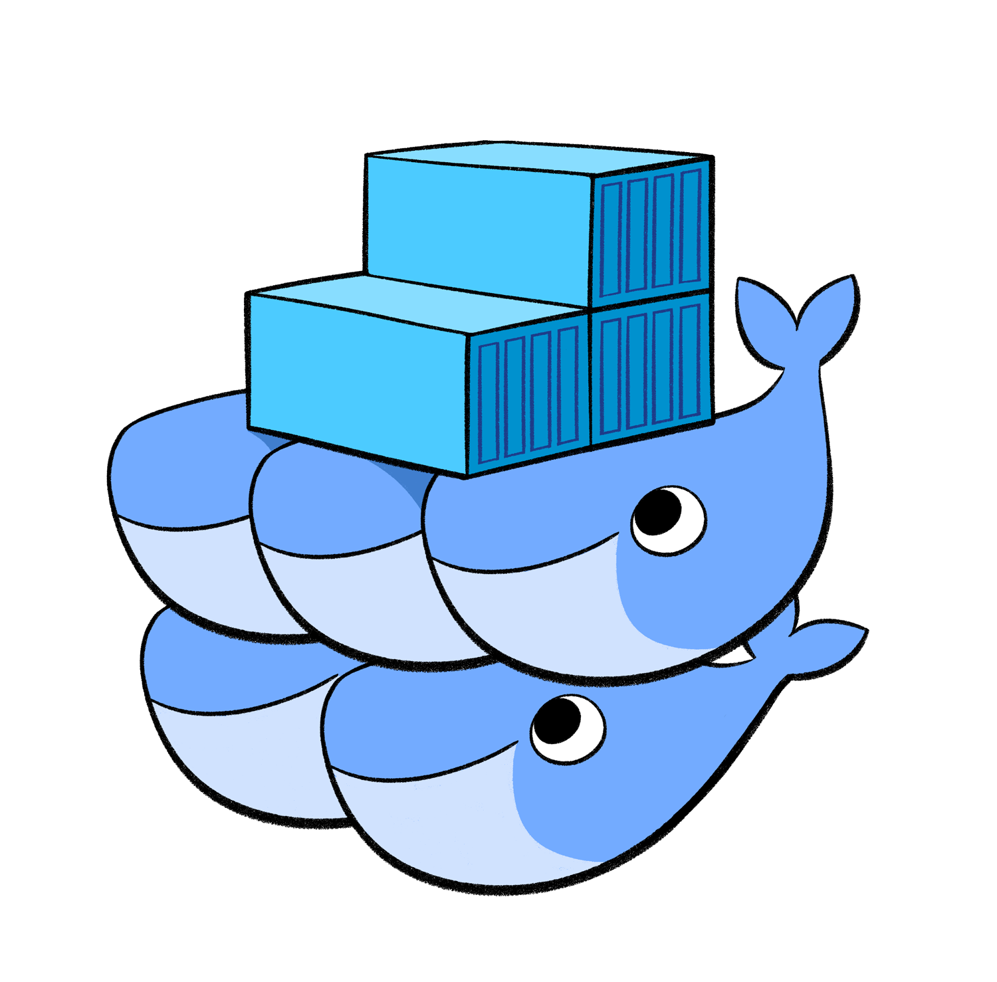



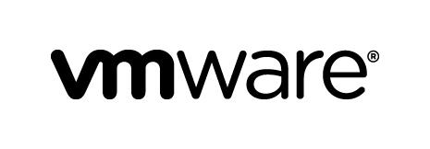

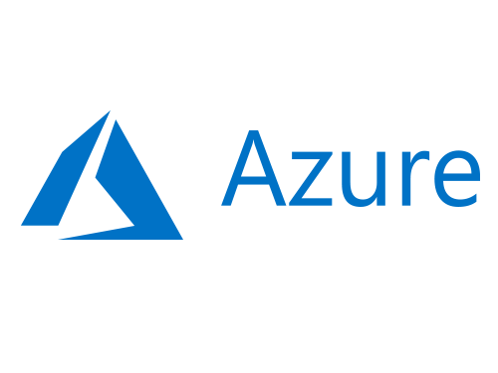

What Does Docker Certified Infrastructure Do?
[Logo Placeholder]
Networking
ENTERPRISE EDITION PLATFORM
SECURITY
AUTOMATION
GOVERNANCE
Storage
Threat Scanning
Policy-based
RBAC
Encryption
Image Mgmt
Integrate
High Availability
Monitoring
Image Mgmt
Self-healing
Policy Mgmt
ORCHESTRATION
Logging
&
Docker Swarm
ENGINE
ENGINE
ENGINE
Access
Load Balance
Deploy, Configure & Scale
*
*
*
*

Slide 38


Docker Certified Infrastructure Technical Details
[Logo Placeholder]
*
VMs
Load Balance
Load Balance
Load Balance
Universal Control Plane
Docker Trusted Registry
Worker nodes
UCP
UCP
UCP
DTR
DTR
DTR
Windows and Linux
High Availability
Scale
High Availability
Scale
Scale

Slide 39
[Logo Placeholder]
Live Demo

Slide 40


Questions?
Christine Lovett |
Solutions Engineer
christine.lovett@docker.com
Al Barnes |
Account Executive
al.barnes@docker.com

